Slide 1
SM Bankers Money Multiplies

Slide 2
ABOUT SM BANKERS
This bank provides various banking facilities
Personal Banking
BitCoin Banking
Loans
General Insurance

Slide 3
Facilities
Personal Banking:
Current
Savings
Fixed Deposits
Bitcoin Banking
Loan Facilities:
Home Loan
Car loan
Personal Loan
Agricultural Facilities:
Loans for farming
Debt waving
General Insurances:
Life Insurance
Health Insurance
Motor Insurance
Travel Insurance

Slide 4
Personal Banking
Current:0
No interest rate offered.
Unlimited number of transactions in a month.
No minimum balance required.
Savings:1
Interest rate 10% offered.
Interest rate based on recent RBI’s Mandate.
5 transactions without service charge.
Minimum balance 1000.
Fixed Deposit:2
Interest rate of 20%
Interest rate calculated annually
No withdrawal for 4 years.
Interest rate calculated based on RBI’s mandate.
Bitcoin Banking:
Redeem bitcoins
Trade bitcoins
Add bitcoins.

Slide 5
Triggers for PB
CountTrans : It counts the number of transactions made by the user in that particular month.
InterestCal : Whenever the user does a transaction this trigger will fire and calculate the interest rate upto that particular time from the last transaction.
BalCheck : It checks whether the minimum balance is met for the respective account before the transaction.
AddInt: Adds the interest rate to the account at required time.
ServiceCharge: Deducts service charge after the minimum number of required transactions.
UpdateTrans: Add the transaction in the Transaction table.

Slide 6
Procedures for PB
Deposit: deposits the amount into the account and updates the last transaction date and increments the central fund.
Withdraw: Deducts the amount from the account and updates the last transaction date and deducts the central fund.
View Balance: Views the balance after combining it with the interest rate earned by the user.
MiniStatement: A report is generated and given to the user for the transactions in the last month.
Full Statement: A report is given to the user which shows all the transactions made by him.

Slide 7
Procedures for PB
AddBitCoin: Adds bitcoins to your account.
TradeBitCoin: It has receiver and sender bitcoin account numbers. It will transfer bitcoins between account and transfers equivalent money.
RedeemBitCoin: Adds bitcoins to the bank bitcoin collection and it will give the customer equivalent money form.

Slide 8
Loans
All loans are based on monthly EMI’s
Education: No interest
Home: 1%
Car: 2%
Savings account is a must for being granted a loan.

Slide 9
Insurance
Three types:
Life: 0.1% per month
Property: 0.5% per month
Health: 0.25% per month
Savings account is a must.
If any one defaults to pay for a few months then the penalty is 75% of the unpaid amount.
If he continues not to pay for atleast 6 months then Insurance can’t be claimed.

Slide 10
Triggers for Loans
DeleteRow: Deletes a row after the loan is paid off
CheckLM: checks whether he paid last month or not. Else his penalty is issued.
CheckOnce: Forfeits all the properties issued as security for those who defaulted payment for 4 consecutive months.

Slide 11
Procedures for Loans
Pay(): Pay the amount by deducting the same from the savings accounts
Remaining(): See the remaining balance and the amount to be paid this month

Slide 12
Triggers for Insurance
Similar to loans
Procedures:
Similar to loans, Additionally:
Claim(): Adds the insured amount to the savings account after checking all the relevant triggers.

Slide 13
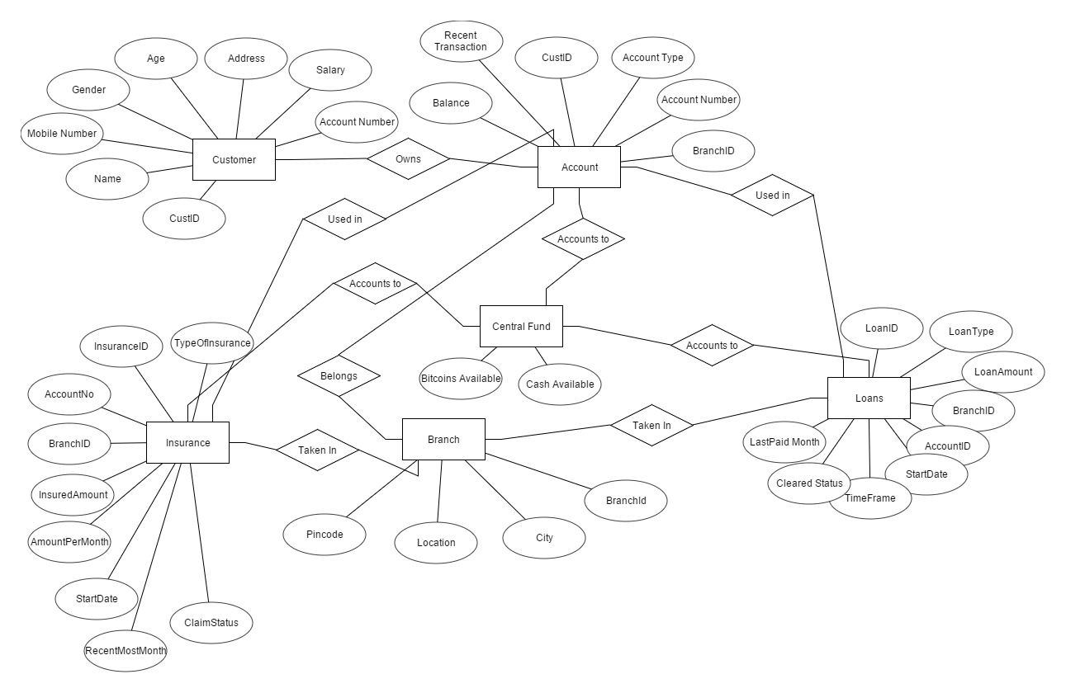
ER - DIAGRAM

